Slide 1
University American College Skopje
Course: Business Computer Applications
Processing Word Document
Marija Stanojeska, PhD

Slide 2

Based on the textbook:
Microsoft Office Inside Out (Office 2021 and Microsoft 365), J. Habraken, Pearson Education, Inc., 2022.

Slide 3
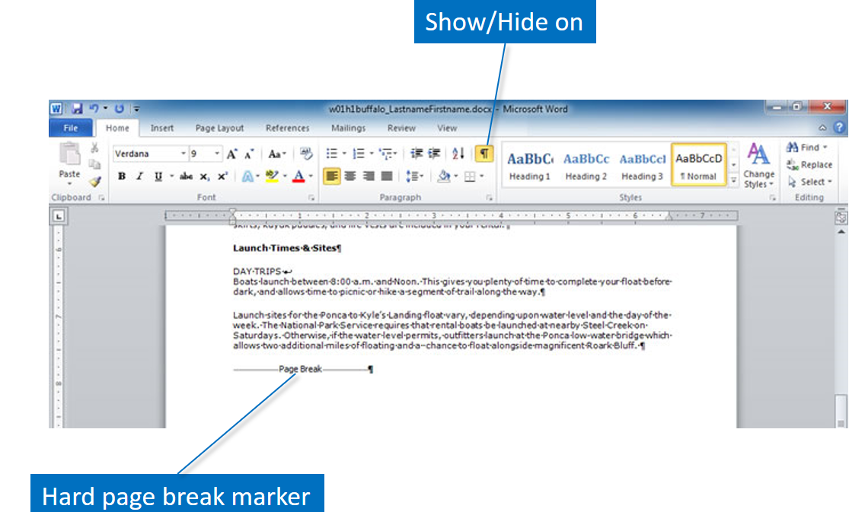
Page break
Just as soft returns happen automatically, soft page breaks also occur as you type more text than fits a page. This type of page break will readjust if you insert or delete text. In some situations you will want to make a page break occur. A hard page break forces the text to begin on a new page. There are several methods for inserting hard page breaks. Click Breaks in the Page Setup group on the Page Layout tab or click Page Break in the Pages group on the Insert tab. You can also press and hold CRTL, and then press Enter.
Shown here is a hard page break. You can only view the marker if you toggle the Show/Hide formatting marks or view the document in Draft view.

Slide 4
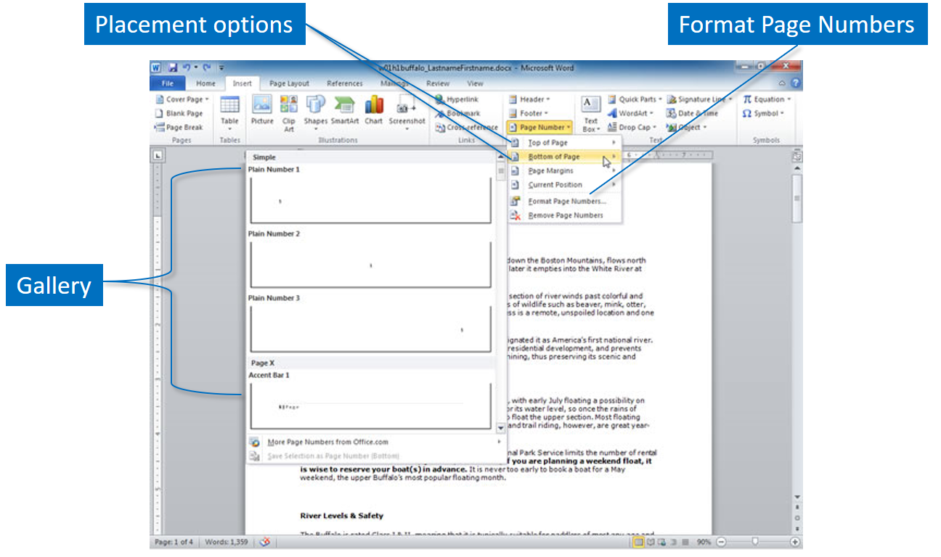
Page numbers
Lengthy documents benefit from the addition of page numbers. They serve as a reference point for the writer and the reader.
The Page Number command in the Header & Footer group on the Insert tab is used to place page numbers into a document. If you add or delete pages, Word will automatically adjust the page numbers. You can select to display the numbers at the top or bottom of the page in the header or footer areas, and they can be left, center, or right aligned.
The gallery shown here displays a few of the options for the placement of the page number in the footer.
.

Slide 5
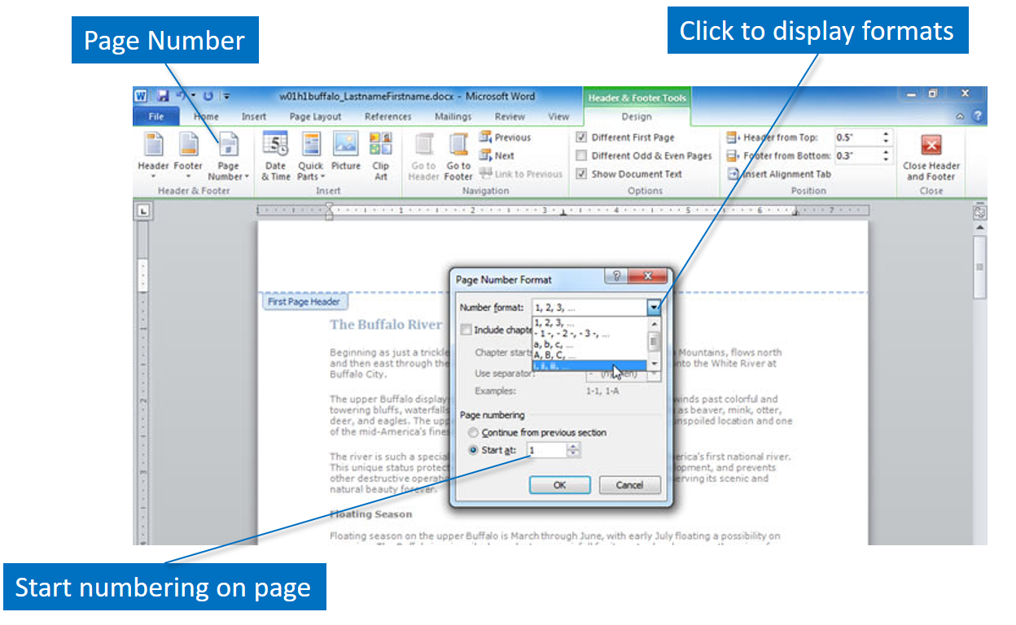
Page numbers (cont.)
Using Word you can customize the format of the page numbers. For instance, you may wish to use Roman numerals on the preface pages and Arabic numbers on later pages. You may also start the page numbering on a page other than the first page, as commonly done when creating the title page. Click Page Number on the Insert tab and then Format Page Number. The feature displays the Page Number Format dialog box.

Slide 6
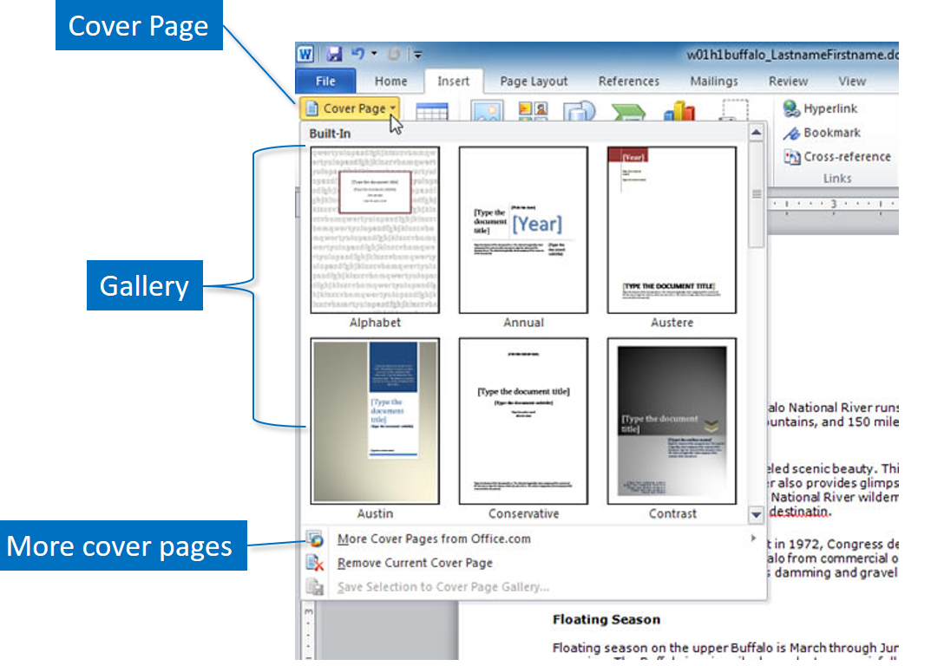
Cover page
Word 2010 offers a feature that enables you to quickly create a preformatted cover page for your document. Click Cover Page in the Pages group on the Insert tab to view the gallery of designs. For each design, fields such as Document title, Company Name, Date, and Author enable you to personalize the cover page. If you do not need a field, you can remove it. Additional cover pages can be downloaded from Office.com.

Slide 7
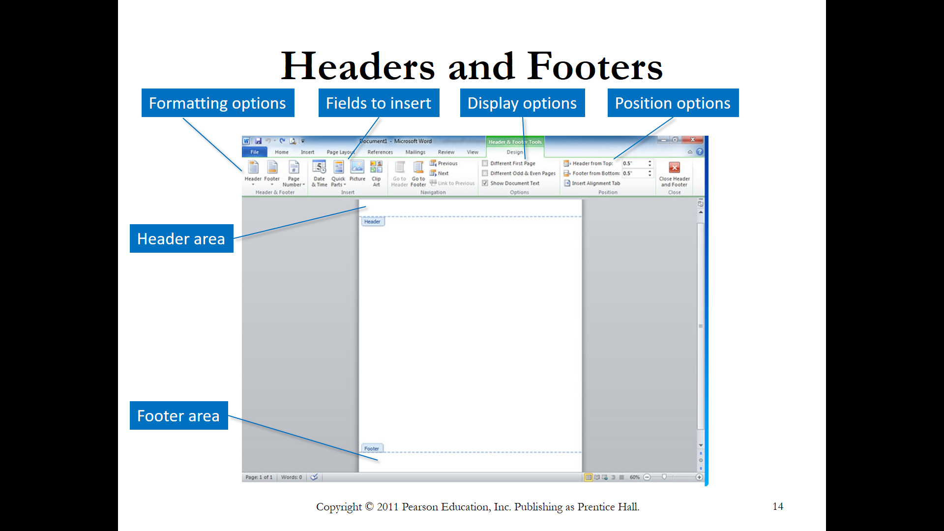
Headers and footers
The header consists of one or more lines of text at the top of each page. The header might include the name of the organization, author, or title. The footer displays at the bottom of the page. If you use the Header and Footer features to set up these areas, they appear automatically on every page of the document. You also have the option to use only a header or a footer, or to use both.
The Header and Footer commands are on the Insert tab. You can format the text just as you would any other paragraph by setting typefaces, sizes, and alignments. The options are available on the Header & Footer Tools Design tab shown here..

Slide 8
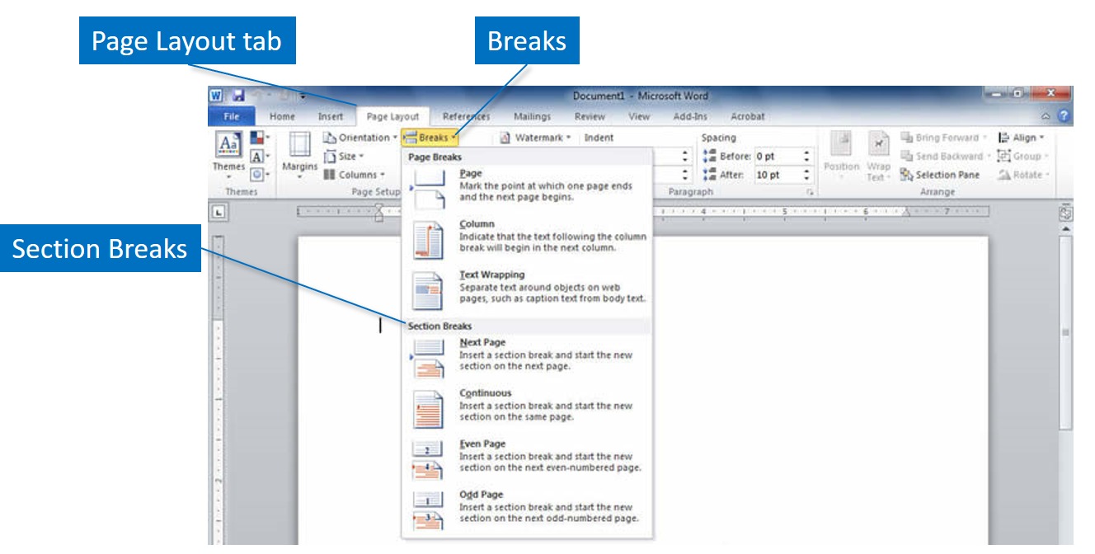
Sections
Sections enable you to use different formatting in different parts of your document. For instance, on one page, you may want to show a chart using landscape orientation, while the rest of the document is in portrait orientation. By using sections, you can divide the document and format each section independently. You can change the margins, page orientation, page numbering, and number of columns in each section.
A section break divides a document into sections. Click Breaks in the Page Setup group on the Page Layout tab and click the type of break you wish to use. Four section breaks are available. The New Page option inserts the break and starts the new section on the next page. The Continuous option inserts the break and the section will start on the current page. When you use Even Page or Odd Page, they behave similarly, inserting the section break and then starting on the next even-numbered or odd-numbered page.

Slide 9
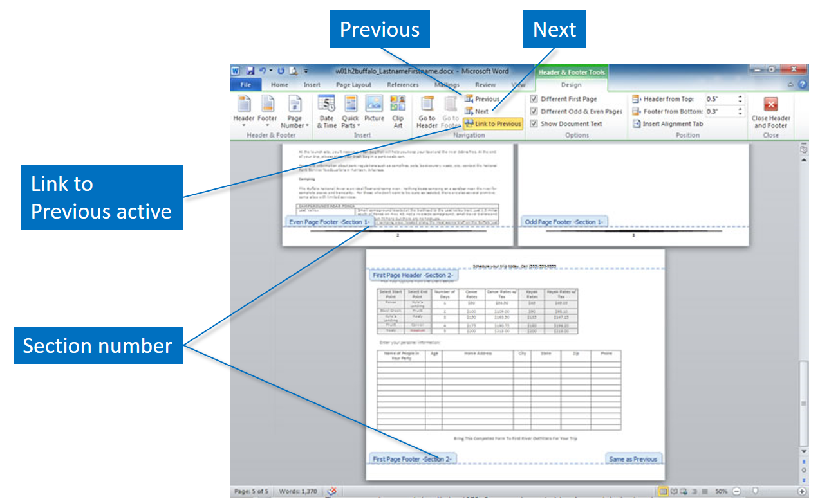
Sections (cont.)
If your document has multiple sections, the Link to Previous feature in the Header & Footer Tools tab enables you to set the page numbering to continue sequentially from section to section. If you want to restart page numbering when a section changes, turn off the Link to Previous toggle. The toggle displays an orange color when active.
Click in the Header/Footer space of the document, then select Next or Previous on the Navigation group of the Header & Footer Tools Design tab to move between the headers and footers of the sections.
Section break locations are viewed using the Draft view or double-click on the header or footer of a page to see the section number. If you delete a section break, the formatting will change to the characteristics of the next section.

Slide 10
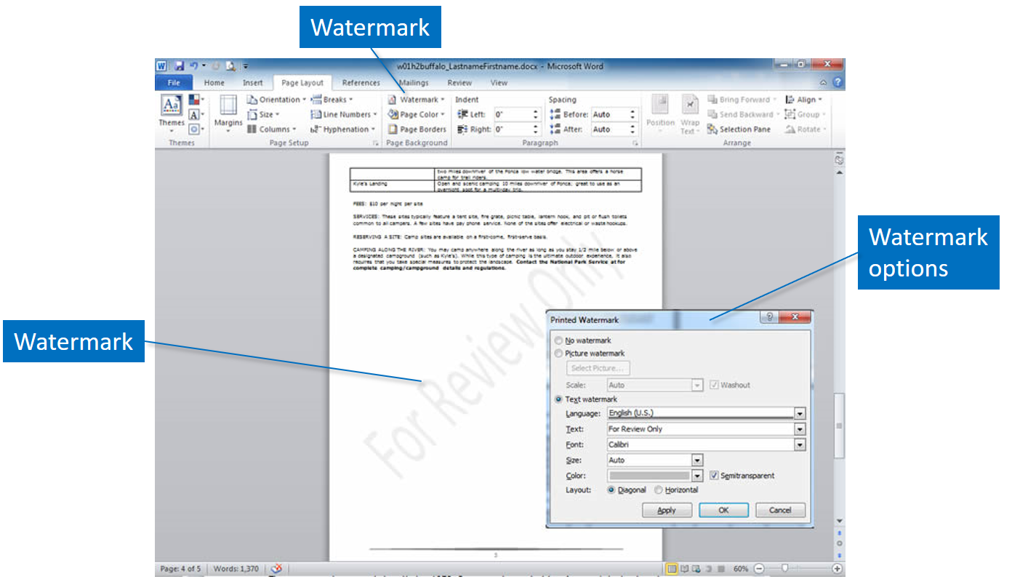
Watermark
Watermarks refer to very light text or graphics behind the text of a document. It is often used by companies to add the logo to documents. Sometimes the status of a document, such as for review only, confidential, or draft is used as watermark text. Shown here are the words For Review Only as a watermark.
On the Design tab, select Watermark. In the Insert Watermark dialog, select Text and either type your own watermark text or select one from the list. Then, customize the watermark by setting the font, layout, size, colors, and orientation. Watermarks do not appear on documents saved as Web pages, so you will not see them if you are in Web Layout view.

Slide 11
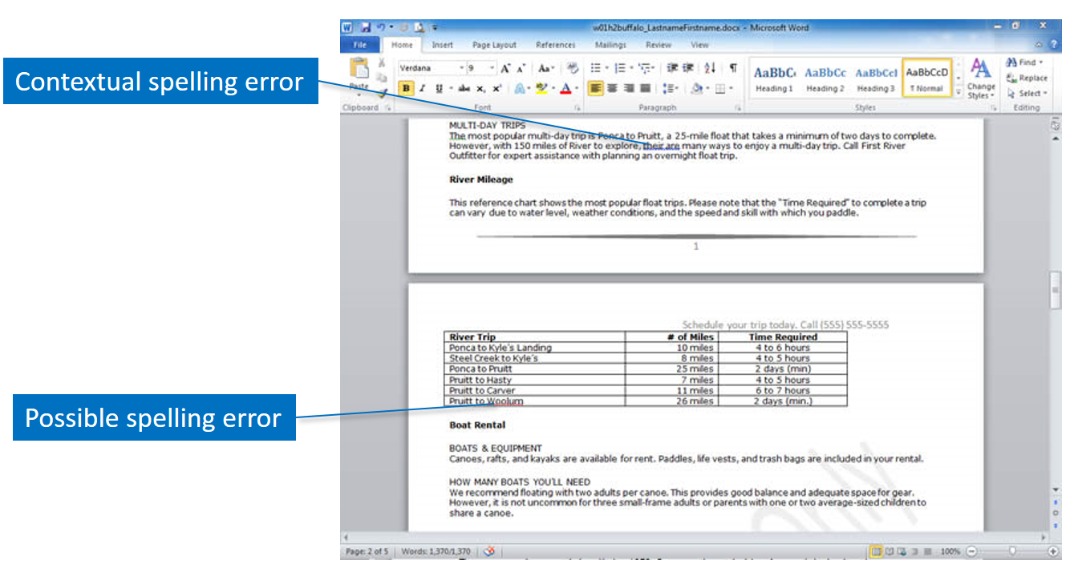
Spelling and grammar
Producing documents without misspelled words and grammar errors is important. Microsoft Word has automated spelling and grammar checker tools which assist you in accomplishing this goal. Regardless, you should carefully proofread all documents because the spelling and grammar checkers may not find every error. Using test, when you actually mean text, is an example of an error that will not be flagged by either of the tools.

Slide 12
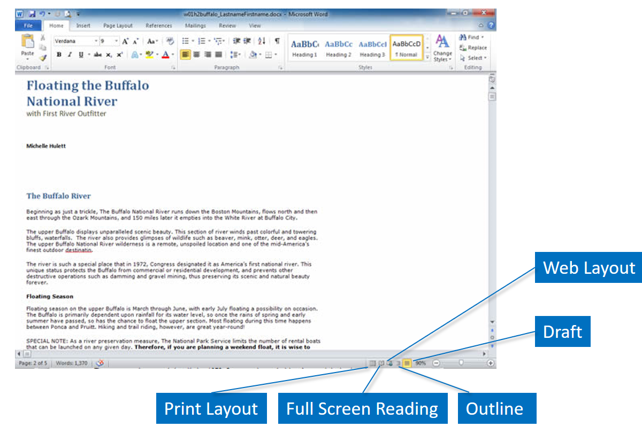
Document views
Word displays your documents in a variety of different views. The view can be changed using the View tab and clicking the desired view from the Document Views group. Buttons on the status bar also enable you to quickly change the view. The Print Layout view is the default view of the documents and looks very much like the printed document. The Full Screen Reading view hides the Ribbon and make it easier to read the document. The Web Layout view shows the document as it would appear if saved as a Web page. The Outline view converts the text into a structural view that can be collapsed or expanded, and opens the Outlining tool tab. The Draft view, is a simplified work area, removing white space and other elements from view.

Slide 13
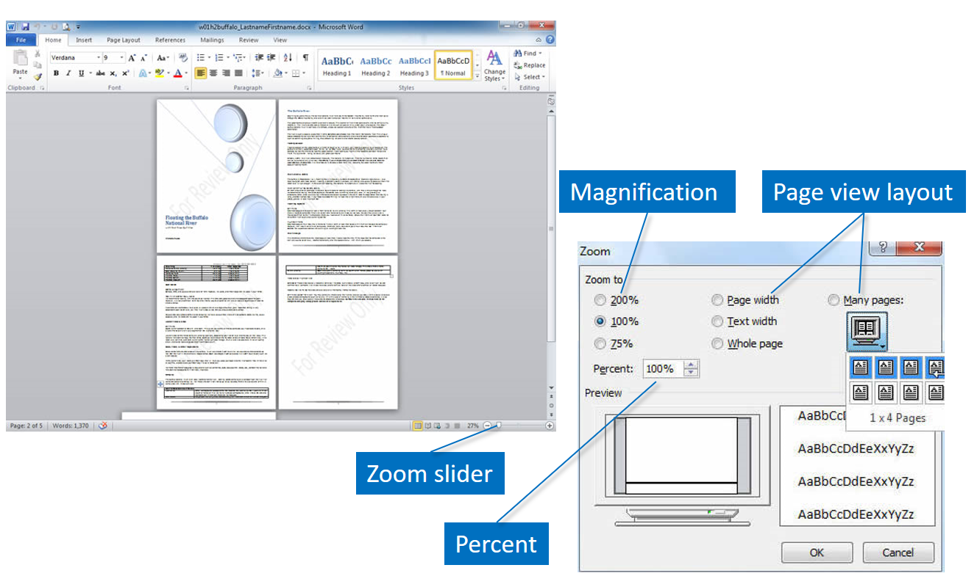
Zoom
The Zoom feature in the Zoom group on the View tab displays several options as shown here. Magnifications range from 75% to 200%, or you can use the Percent box to type a number. If you select Page width, Text width, or Whole page, Word automatically determines the magnification. Use the Many pages option to view more than one page at a time and select the pages by dragging over the pages you wish to see, as shown here. The document on the right is displaying pages shown in 2 X 2 format. You can also use the Zoom slider on the status bar to change the magnification.

Slide 14
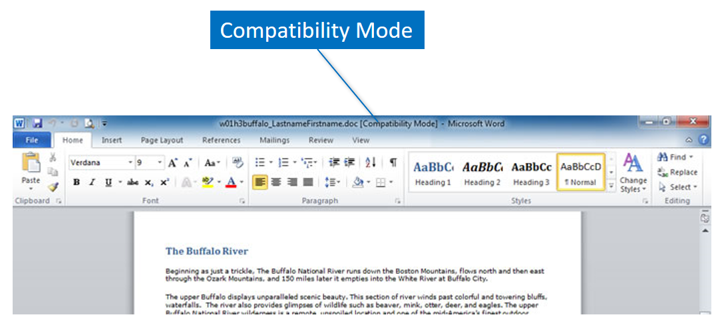
Compatibility Mode
If you open a Word document created in a previous version of Word, the title bar indicates Compatibility Mode, as shown in this figure. You will still be able to work with the document and save it, but some features introduced in later versions of Word are not available for use. For instance, SmartArt and graphic enhancement options found in Word 2010 are not going to work in a Word 2003 document.
You can remove a document from compatibility mode by converting it to Word 2010. Click the File tab, and then click Convert. The file will be converted, but it will still display the .doc extension until you save the file. After making it compatible, you can use all of the features of Word 2010.

Slide 15
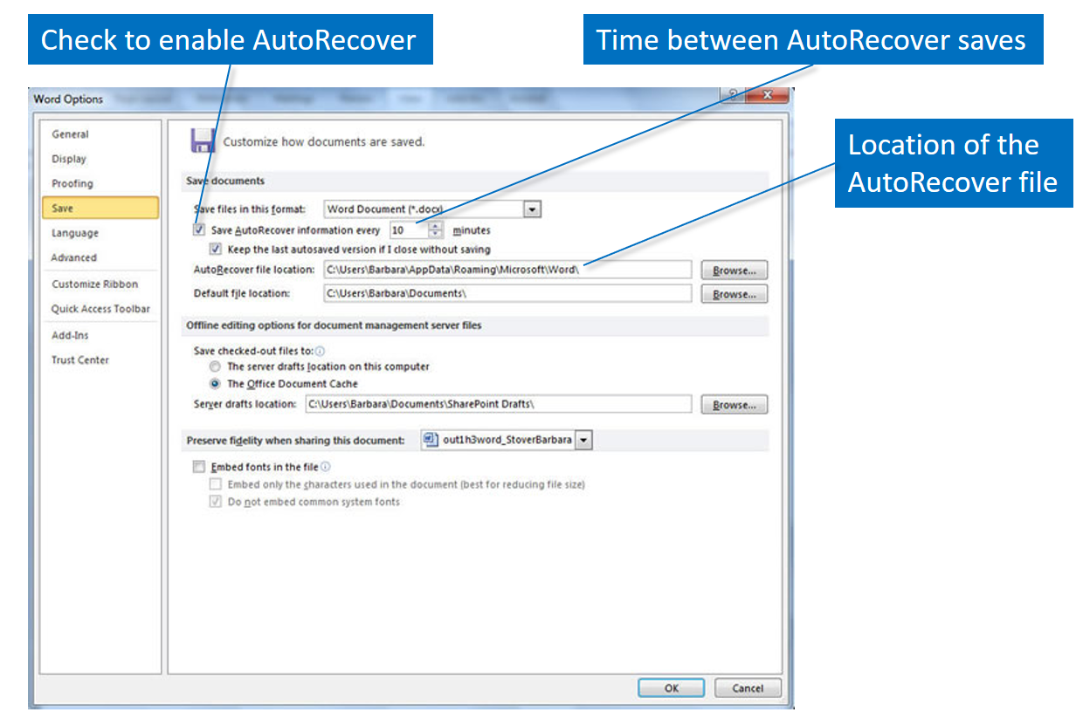
Backup options
Word enables you to backup your files in different ways. If AutoRecover is enabled, it helps you to recover the previous version of a file if Word crashes. The only work you would lose is that which took place between the last AutoRecover save and the time of the crash. The AutoRecover actions are set on the File tab. Click Options, and then Save, as shown here, to change the length of time between AutoRecover saves and the location of the saved files.

Slide 16
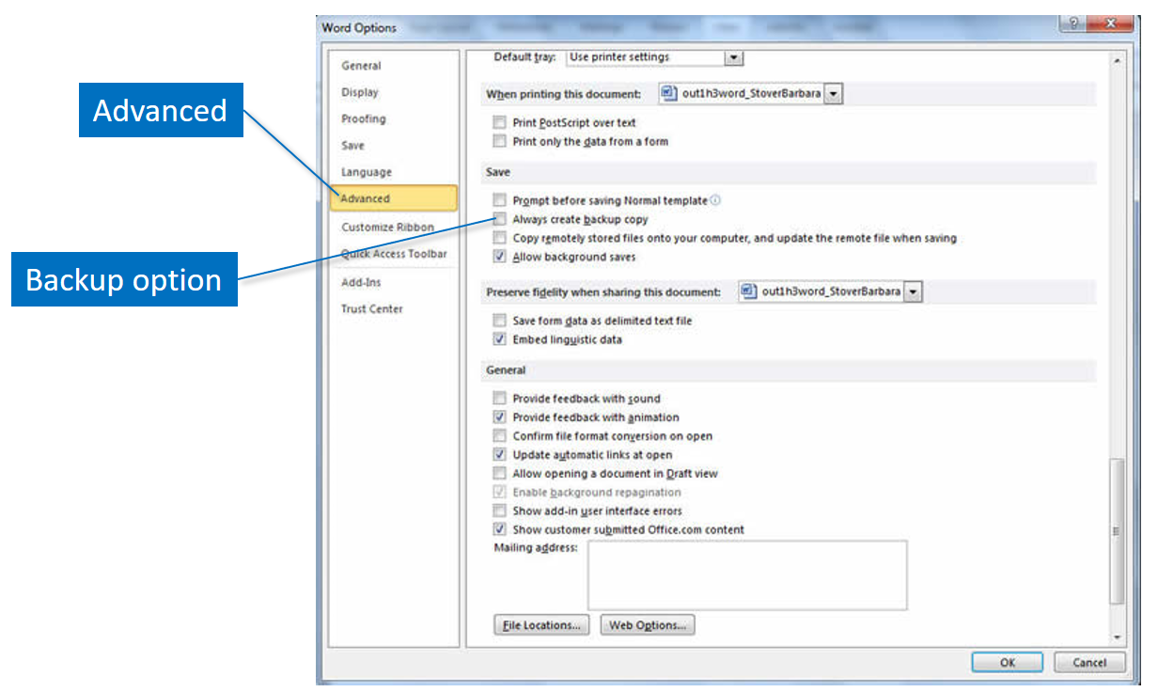
Backup options (cont.)
Another backup option you may want automatically creates a backup copy every time you save. You now have two versions of the file on the computer, one designated as the backup file and the other as the new version of the file. When you save the next time, the previous version becomes the backup file and the current version is saved as the “new” file. Regardless of the number of times you save the document, only one backup file will be available. Using this backup option enables you to use the backup file if the original file is accidently erased or edited incorrectly. One disadvantage is that this puts two copies of every file onto your computer, possibly using valuable storage space.
The option to backup files is not set by default. Click the File tab, and then click Options. Click the Advanced tab and scroll down to the Save options. Select Always create backup copy, and then click OK.

Slide 17
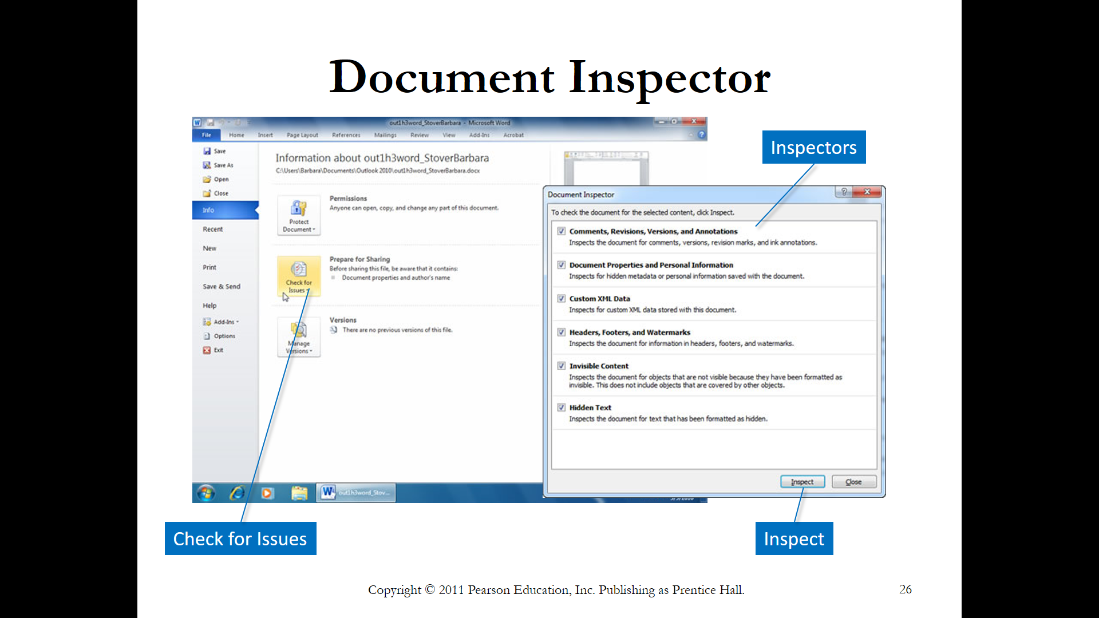
Document inspector
The Document Inspector checks for and removes different kinds of hidden and personal information from a document, for privacy or security reasons. Shown in the dialog box are the types of content that are affected by the Document Inspector. Because some information that the Document Inspector might remove cannot be recovered with the Undo command, you should always save a copy of the original document, using a different file name, before running any Inspector.
Click the File tab, and then click Check for Issues. Click Inspect Document to open the Document Inspector dialog box, shown here. Select the types of content you want to check and click Inspect. Word lists the results and enables you to choose whether to remove the content from the document.

Slide 18
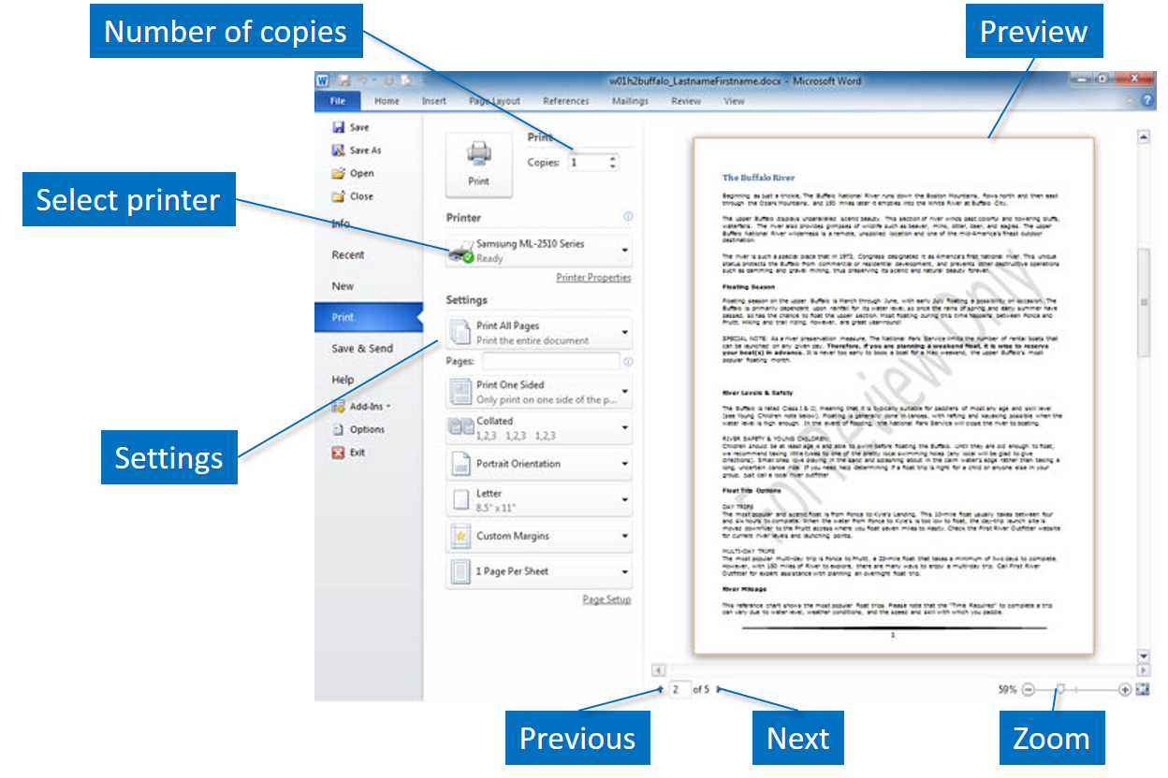
Printing options
As you finalize your document and prepare to print it, you should review the print preview carefully. This keeps you from printing pages that you will not be able to use. The print preview appears automatically on the Backstage view when you click the File tab and Print. Use the Previous Page and Next Page arrows to move between the pages. You can zoom to magnify the page or view several pages at once on the Backstage view.
There are many options available when you are ready to print the document, as shown here. You can select the number of copies to print, select a different printer, and specify settings that include printing all of the pages, printing one-sided copies, and collating the copies. Additional specifications are orientation of the printouts, the paper size, margins, and number of pages per sheet.

Slide 19
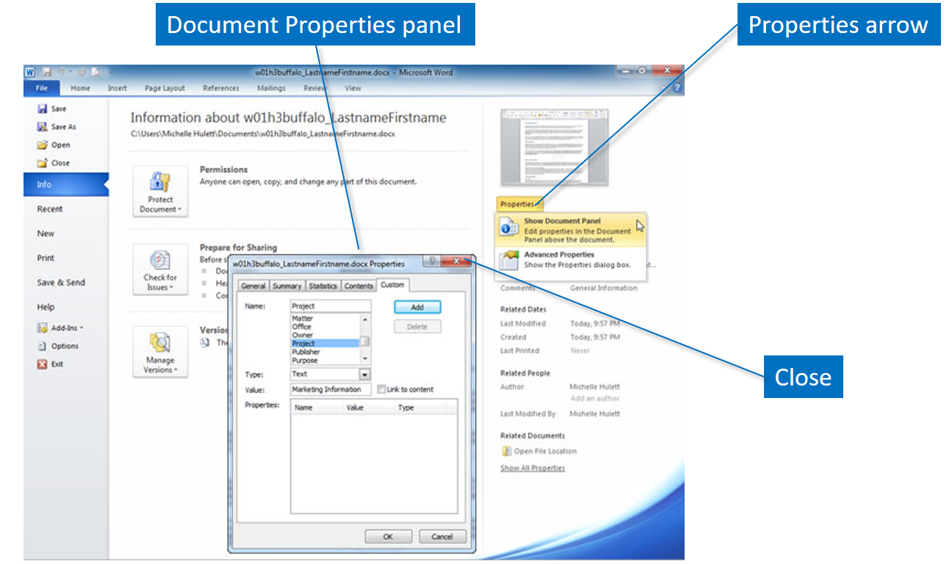
Document properties
The properties for a document are shown in Info, on the Backstage and include statistics such as the size of the file, pages in the documents, the number of words, the editing time, and dates created and modified. Also, you may open it in View, and Properties. You can add additional detailed information to the Document Panel such as notes to yourself about the document, the document’s author, purpose or intended audience. To display the full Document Panel, click the File tab, and then the Properties arrow. Click Show Document Panel to display the panel as shown here. After placing the information into the boxes on the panel, click the close button on the panel. The information will be saved with the file as you save the document, but it will not appear in the document.
If you wish to print the Document Properties, click the File tab, and then click Print. Click Print All Pages, click Document Properties, and then click Print.

Slide 20
Document presentation

Slide 21
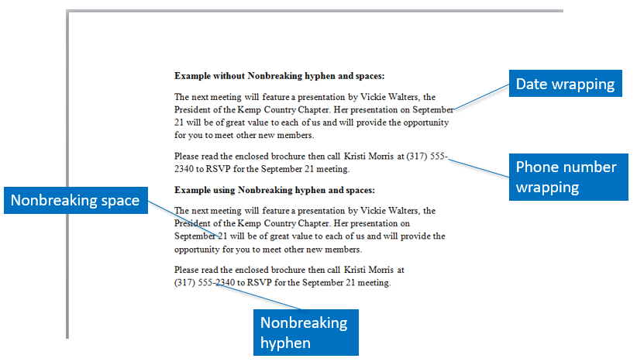
Word wrapping
A nonbreaking hyphen prevents a word from becoming separated at the hyphen at the end of a line. Phone numbers, as shown here, read better if they are not on two lines. To insert a non-breaking hyphen, press Ctrl+Shift+Hyphen.
A nonbreaking space keeps words together, so that they do not wrap, and thus improves the readability of the words. Some examples of things that should stay together are months and days, shown here as September 21, names such as Ms. Moody, and page references such as page 15. Place a nonbreaking space between words by pressing Ctrl+Shift+Spacebar. Notice that the area code is kept on the same line as the phone number with a nonbreaking space.

Slide 22
Paragraph formatting
Another way to change the appearance of a document is to change the paragraph formatting, which includes alignment, indentation, tab stops, or line spacing. You can control where the page breaks. You can include borders or shading for added emphasis. By adding paragraph formatting elements, you break up long blocks of text and make the page more attractive to readers.
Alignment
Indentation
Tab stops
Line spacing
Pagination
Borders
Shading

Slide 23
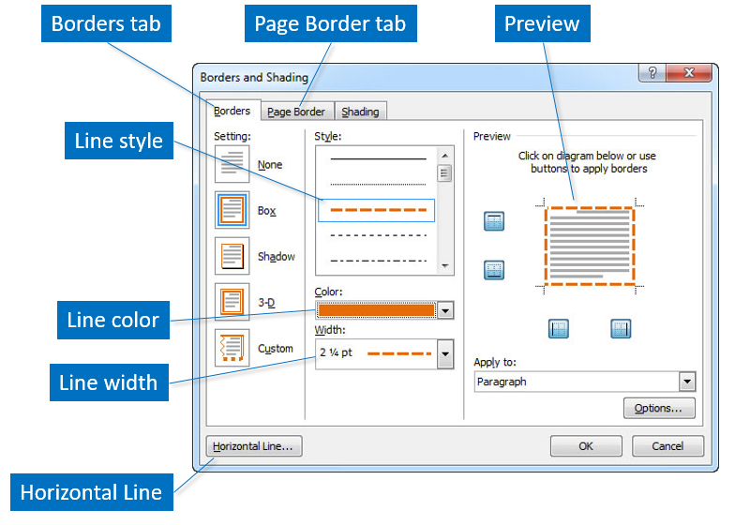
Borders and shading
Borders and shading draw attention to important parts of the document by setting them apart from the rest of the text. A border is a line that surrounds a paragraph, a page, a table or an image. Shading is a background color that appears behind the text. Click the Borders arrow in the Paragraph group on the Home tab to open the Borders and Shading dialog box shown here.
Page borders are decorative borders you place around one or more pages. This design element can be applied in a variety of ways, including down either side of the page, across the top or bottom, or entirely framing the page. Click the Page Border tab of the Borders and Shading dialog box to select the characteristics for the page borders.

Slide 24
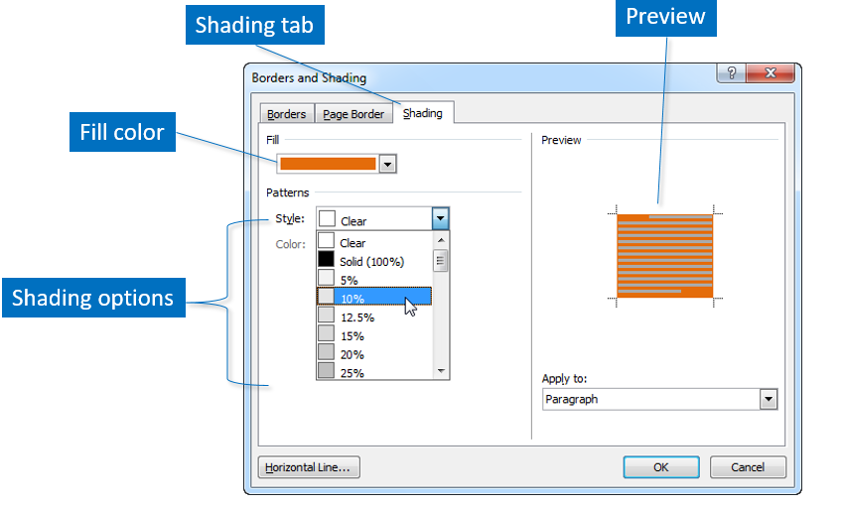
Borders and shading (cont.)
Shading is applied separately from the borders, although they share the same dialog box. Click the Shading tab on the Borders and Shading dialog box to set the shading characteristics. The default shading is clear. Solid shading is a 100% fill of color. Usually not a lot of shading is needed to add emphasis to a paragraph. Patterns can also be applied as shading on top of the color you select. Make sure the text is readable when you apply shading to text blocks.

Slide 25
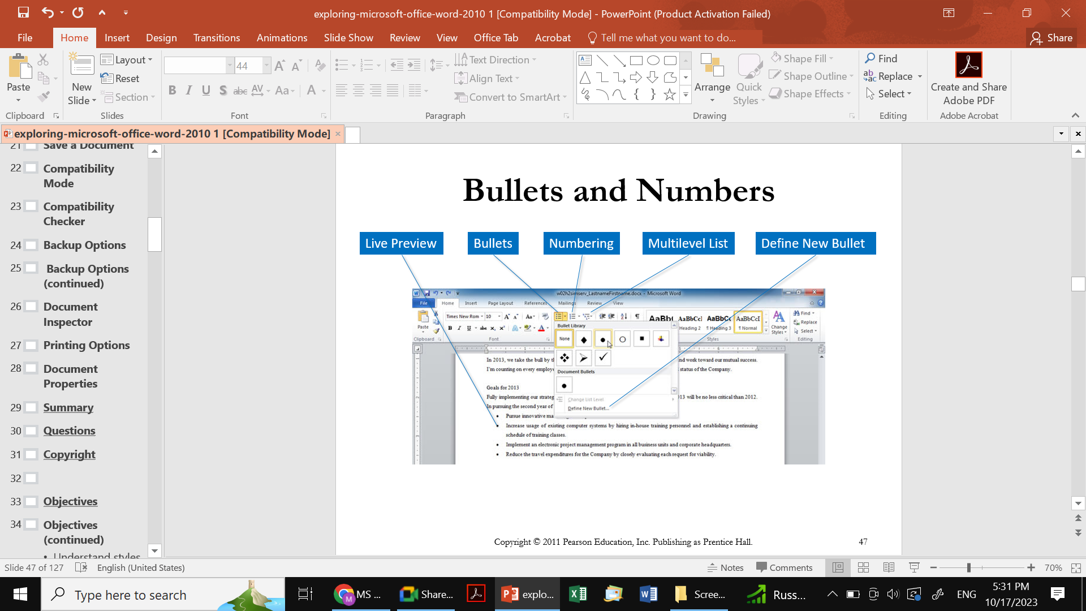
Bullets and numbers
Lists help organize the thoughts of the readers. A bulleted list is used for items that do not have to be in a sequence, while a numbered list is generally used for a series of steps. A multilevel list is an extension of the numbered list and enables you to provide levels within the numbered list. An advantage of creating lists in Word is that when you make adjustments to the list, the numbering is automatically updated.

Slide 26
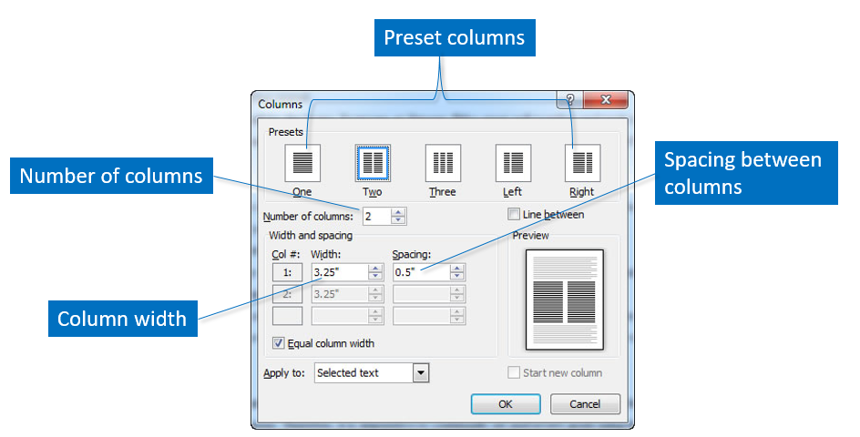
Columns
Columns make text somewhat easier to read, by shortening the length of the lines. Microsoft Word calculates the width of the columns on the page based on the margins and the spacing between the columns. You specify the preset column layout you wish or customize the column width by changing the values in the number of columns, widths, and spacing fields. A preview is shown on the Columns dialog box. Click the Page Layout tab, click Columns, and then click More Columns to display the Columns dialog box.

Slide 27
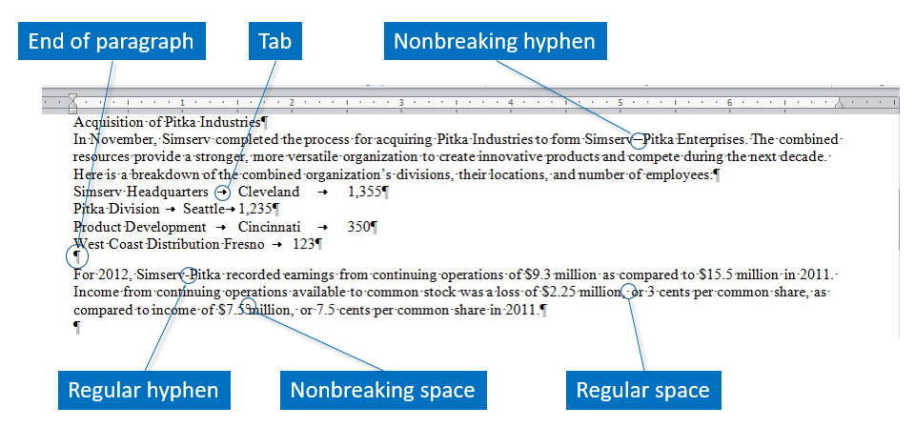
Nonprinting formatting marks
Nonprinting formatting marks are added to your document as you type. They do not appear on printouts, but they do affect the appearance of the document. To see the nonprinting formatting marks click Show/Hide in the Paragraph group on the Home tab. You already know about the nonbreaking hyphen and nonbreaking space from a previous slide in this presentation. A regular space is shown with a dot, while the end of the paragraph is shown with a paragraph symbol. A tab is displayed as an arrow. The Show/Hide feature is a toggle, so click once to see the formatting marks, and click again to hide them. Some people prefer to work with the formatting marks visible, while others do not like to see them.

Slide 28
Text alignment
The horizontal alignment of a document refers to the placement of the text between the margins. Four samples are shown here.
Justified text has added spaces within the text to force the ends of the lines to the right margin. Notice how it appears to be a rectangular block of text. Justified text is often seen in books, magazines, and newspapers. It is generally considered a more formal method of aligning text.
Left aligned text is probably the easiest to read. The lines of text are aligned on the left side of the page, but the right side is ragged. There are no extra spaces between the words, and the ragged right side adds white space to the text, making it more informal.
Right aligned text is used for figure captions, document headers and footers, or short headlines. Along with centered text, it is considered hard to read because the beginnings of the lines are ragged and it is difficult to find your place as you try to read it.
Centered text is used for effect rather than readability on invitations, poems, or formal announcements.

Slide 29
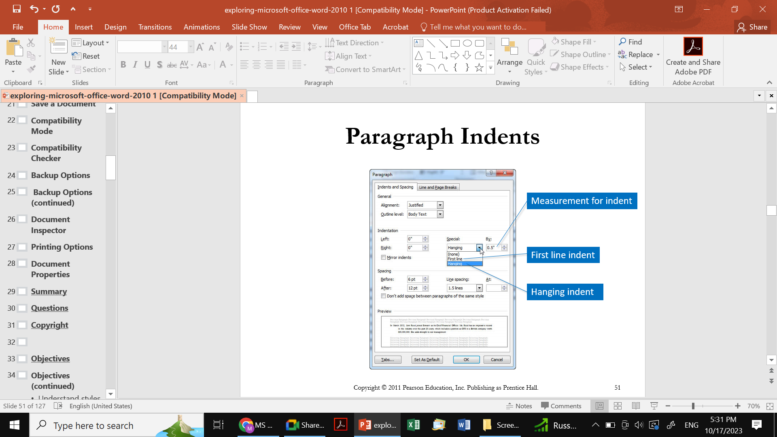
Paragraph indents
Entire paragraphs of text can be indented so that they appear to have different margins than the rest of the text. You can indent the paragraph on the left side only, the right side, or both sides. Quite often you see larger quotations placed in an indented paragraph to indicate that the work is a quotation.
Special indention is also possible for first line indents and hanging indents. A first line indent marks the location of the indent only on the first line in a paragraph. You press Tab to apply the indent. A hanging indent marks how far to indent each line of the paragraph except the first. This makes the first line stand out to the left, with the rest of the lines indented below it. You see hanging indents used on bulleted or numbered lists, and to format citations on a bibliography page.
The Paragraph dialog box is displayed by clicking the Paragraph Dialog Box on the Home tab.

Slide 30
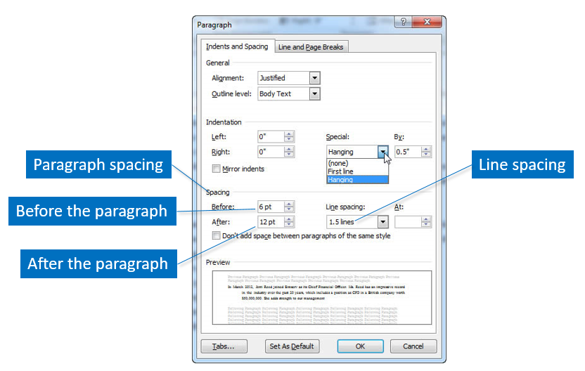
Line and paragraph spacing
Line spacing is the space between lines in a paragraph. You are probably familiar with single spacing and double-spacing. Using the Paragraph dialog box, you have multiple line spacing options and you can also set the spacing in points.
Paragraph spacing is the amount of space before or after a paragraph and can be set independently of the line spacing. In other words, you can set the line spacing to single spacing, but add 12 points of spacing after the paragraph to make it appear to be double-spaced. The paragraph spacing can also be set on the Page Layout tab.

Slide 31
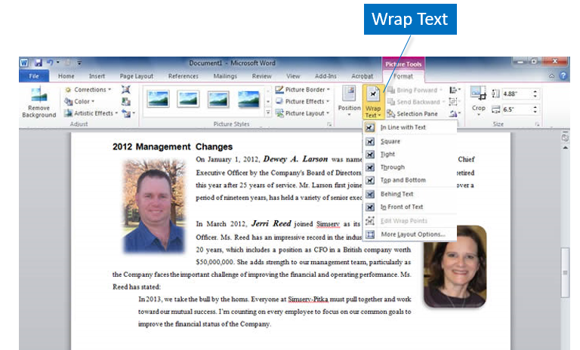
Text wrapping
Once you have placed a graphic in a document, you can wrap the text around the graphic. Click Wrap Text in the Arrange group to display the wrap options. As shown here, the text is wrapped around the photographs using the square wrap option. Additional options include In Line with Text, Tight, Through, Top and Bottom, Behind Text, and In Front of Text.

Slide 32
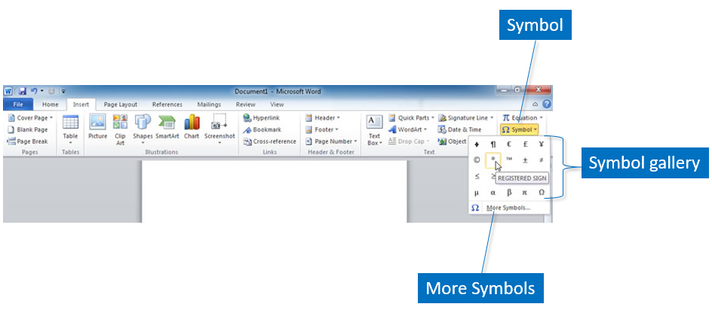
Symbols
The Symbol feature, on the Insert tab, enables you to type typographic symbols and/or foreign language characters in place of ordinary typing. A popular symbol is the c within a circle to indicate copyright. These symbols give the document a professional appearance. Click Symbol on the Insert tab, and then click the appropriate character, as shown on this slide. If the character you wish to use is not in the gallery, click More Symbols to display the Symbol dialog box. Each font has different symbols available which can be used in regular text or as bullets.

Slide 33
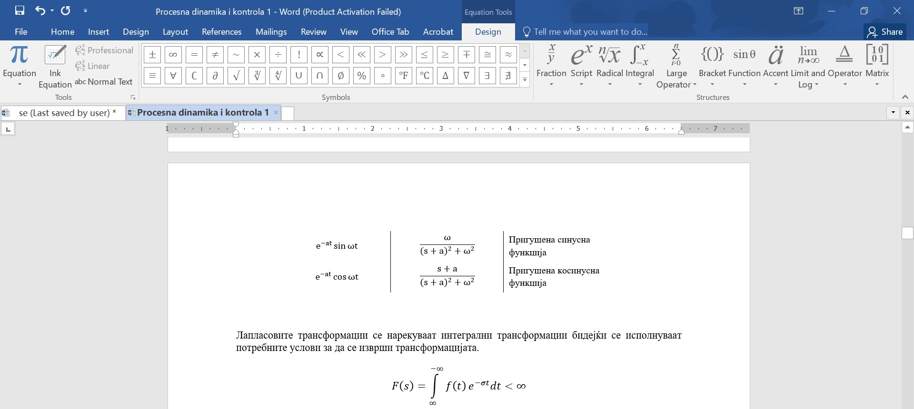
Equation
The Equation feature, on the Insert tab, enables you to type equations in the text. These equations give the document a professional appearance. Click Equation on the Insert tab, and then click the appropriate type of formula.

Slide 34
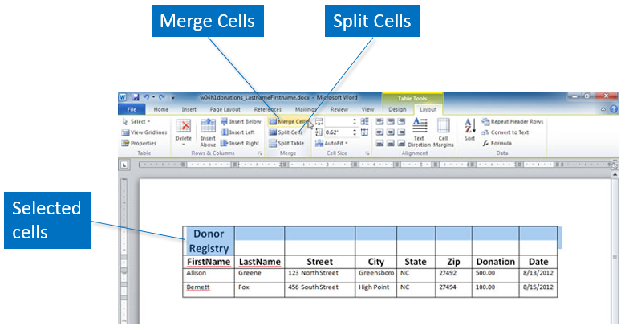
Merge and split cells
At times, you will want to merge or split cells so that they conform to your needs. For instance, you may wish to merge all of the cells in the top row of a table for a heading. To merge cells, select the cells, row, or column to merge, and then click Merge Cells on the Table Tools Layout tab, as shown here. To split a cell into two or more rows or columns, select the cell you wish to split and click Split Cells. In the Split Cells dialog box, change the number of columns or rows to indicate how you want the cell divided.
To select a row, column, cell, or table, on Home click Select on the Table Tools > Layout tab, and then make a selection. This is an efficient way to select the parts of the table if you have an insertion point placed in the table.

Slide 35
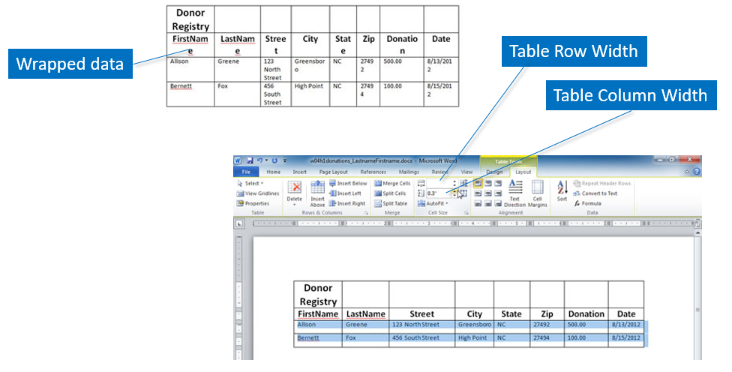
Change height and width
Often adjustments are needed to the row height or the column width so that the data fits and does not wrap within the cell. The first table shown here displays the data wrapped in the cells, making it difficult to understand. Select the column or row that needs adjustment, and increase or decree.se the measurement number as needed on Home click Select on the Table Tools > Layout tab > Width or Height box.

Slide 36
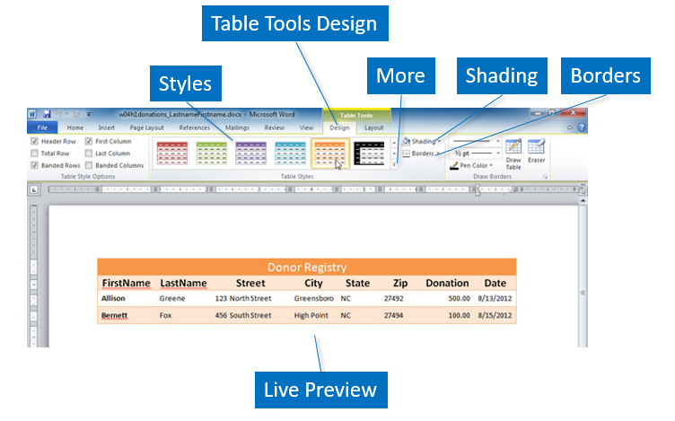
Formatting a table
Borders and shading can be used to enhance the looks of the table. Borders are the lines around each cell of the table. Shading places a background color within a cell or group of cells. For instance, you may shade the heading of the table to make it stand out from the data. Borders and Shading commands are available on the Home tab, as well as Table Tools Design tab.
Predefined table styles that contain borders, shading, font sizes, and other attributes are available on the Table Tools Design tab. Click anywhere in your table and then click a style from the Tables Styles gallery. A Live Preview will display the style on your table when you hover the mouse pointer over the style in the gallery. These styles can be modified to make the table uniquely yours.

Slide 37
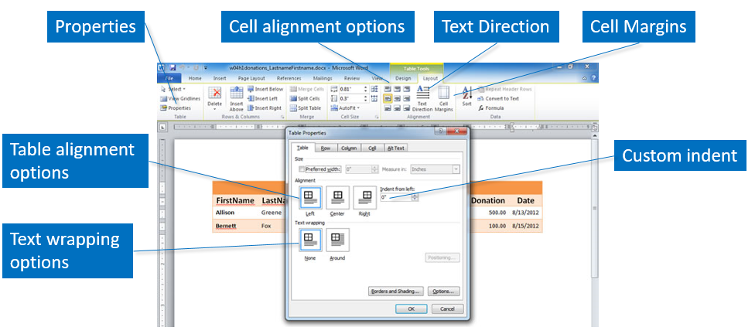
The position and alignment
The position of a table between the left and right margins of the document is table alignment. By default, tables are left aligned. Home > Table Tools Layout > Click Properties dialog box.
You can also choose from two text wrapping options on the Tables Properties dialog box. This enables you to place text next to a smaller table so you will not waste space in the document.
The alignment of data within the cells can also be controlled. You can align the text in many different horizontal and vertical combinations using the Align commands in the Alignment group of the Table Tools Layout tab. The options include Align Top Left, Align Center, Align Bottom Right, and more. The Text Direction command rotates the text so it displays sideways.
An additional alignment command, the Cell Margins command, enables you to change the margins within each cell or between the cells of the table.

Slide 38
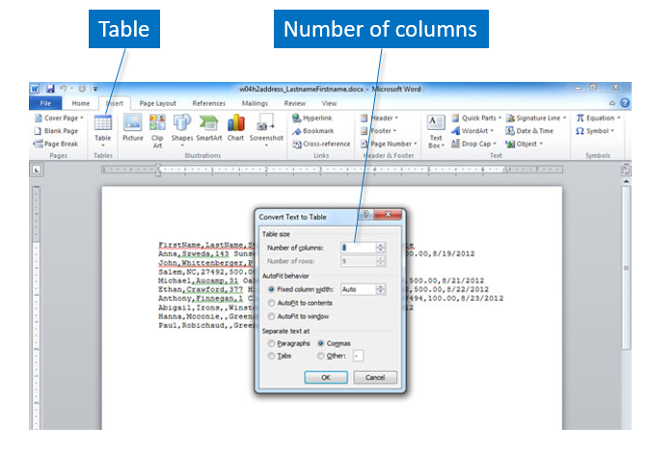
Convert text to table
Text can be converted to a table after you have typed it into the document. For example, you have typed a list with two items per line separated by a tab and realize that it would look better sorted. Select the text, and click Table on the Insert tab. Click Convert Text to Table, select the number of columns and rows, the AutoFit behavior, and the method for separating the text. You can also convert a table to text.

Slide 39
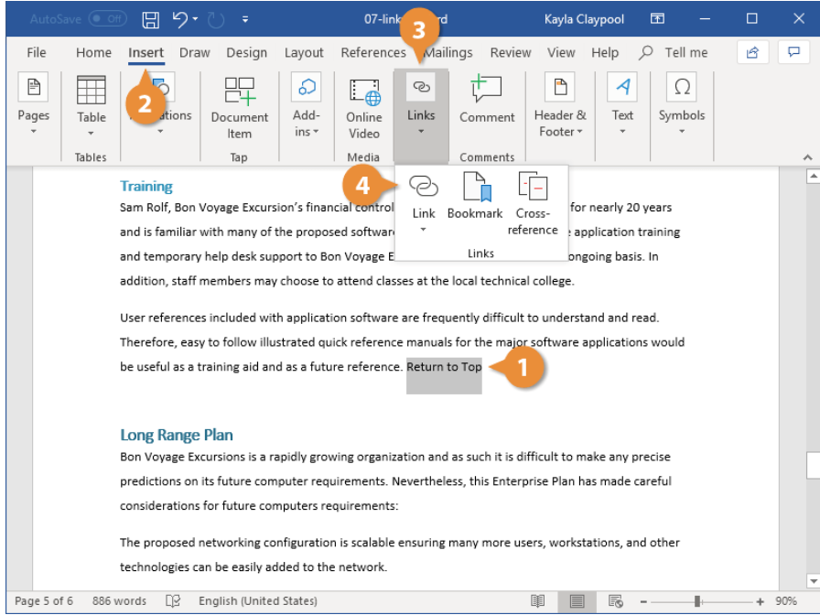
Hyperlink
A hyperlink in Word acts just like one you see on a webpage or email. When you hyperlink text or graphics, they become clickable and connect you to outside information or to somewhere else within your document. Insert a link include following steps: (1) select the text or graphic you want to use as a hyperlink, (2) click the Insert tab, (3) expand the Links group, if necessary (4) click the Link button. Press Ctrl + K.

Slide 40
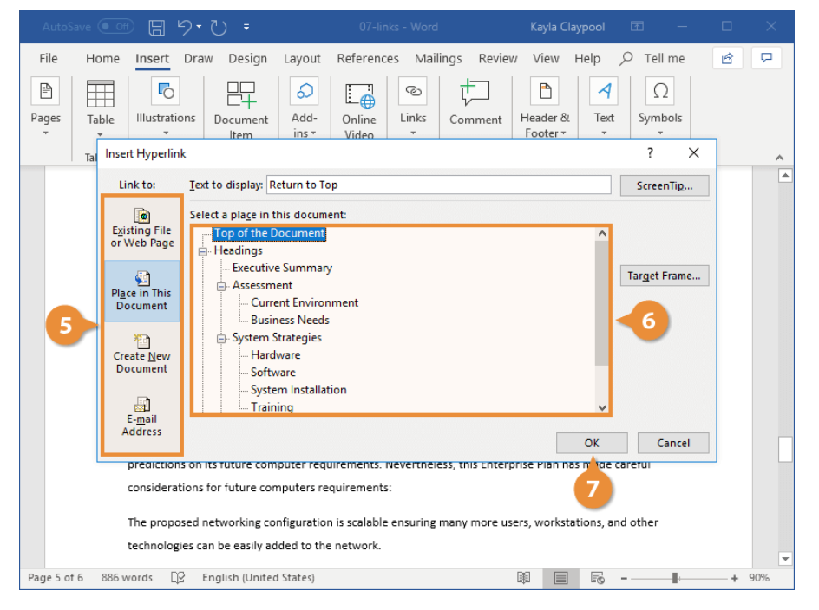
Hyperlink (cont.)
Select the type of object you want to link to on the left side of the dialog box (5):
Existing File or Web Page: Creates a link that takes you to another document, a file created in another program like an Excel worksheet, or to a webpage.
Place in This Document: Jumps to a heading or bookmark in the same document.
Create New Document: Creates a new Word document, then inserts a hyperlink to the new document.
E-mail Address: Creates a clickable email address that will create a new email message when clicked.
Specify where the link should lead to (6):
Depending on what you’re linking to, you’ll have different options here. Specify an external file or webpage, a heading or bookmark in the document, a new file name, or an email address.
Click OK (7).

Slide 41
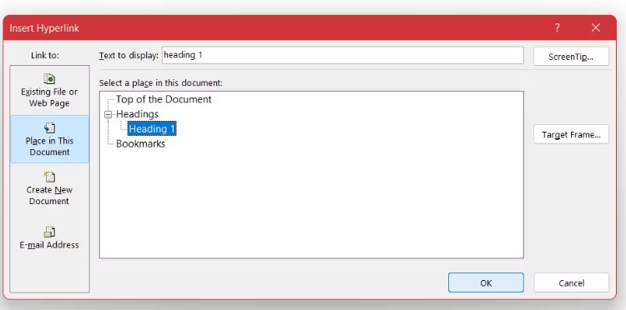
Linking to a place in a document
You can also create a hyperlink that leads the reader to different sections of your documents. Naturally, the requirement for creating such a hyperlink is having structures such as headings or bookmarks in your document to target. Although, you can always create a link to the top of the document.
Select your text or image and right-click it.
In the right-click menu, select Link.
In the Insert Link window, select Place in This Document.
Select the target destination for the hyperlink.
Click OK.
Now you have your hyperlink. You can click it while holding down Ctrl on your keyboard to see it at work.

Slide 42
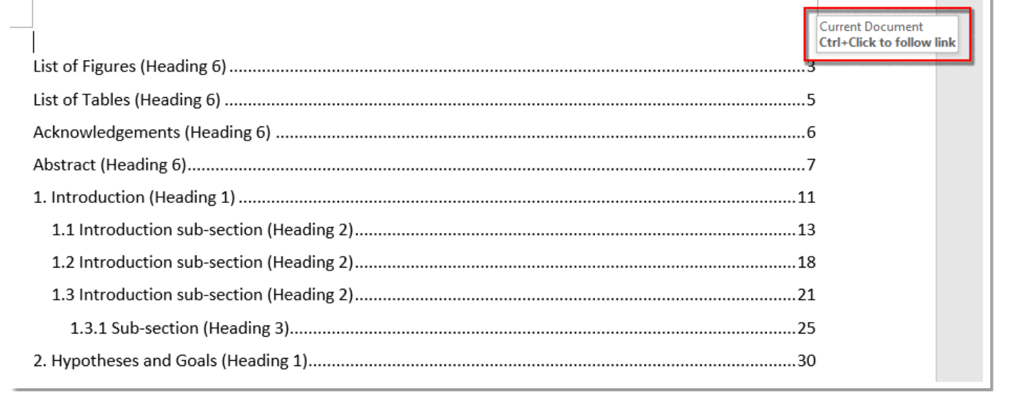
Table of contents link to a pages
In Word, you may type a large of contents into the document. And for reading pages better, you may split them into several parts, such as list of figures, list of tables, abstract and so on. The method on list a table of clickable contents in Word document as follows.

Slide 43
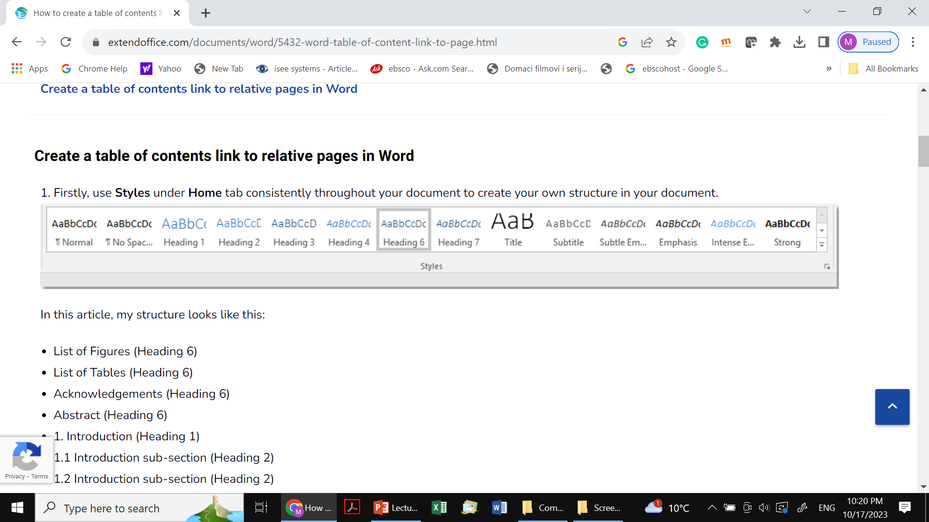
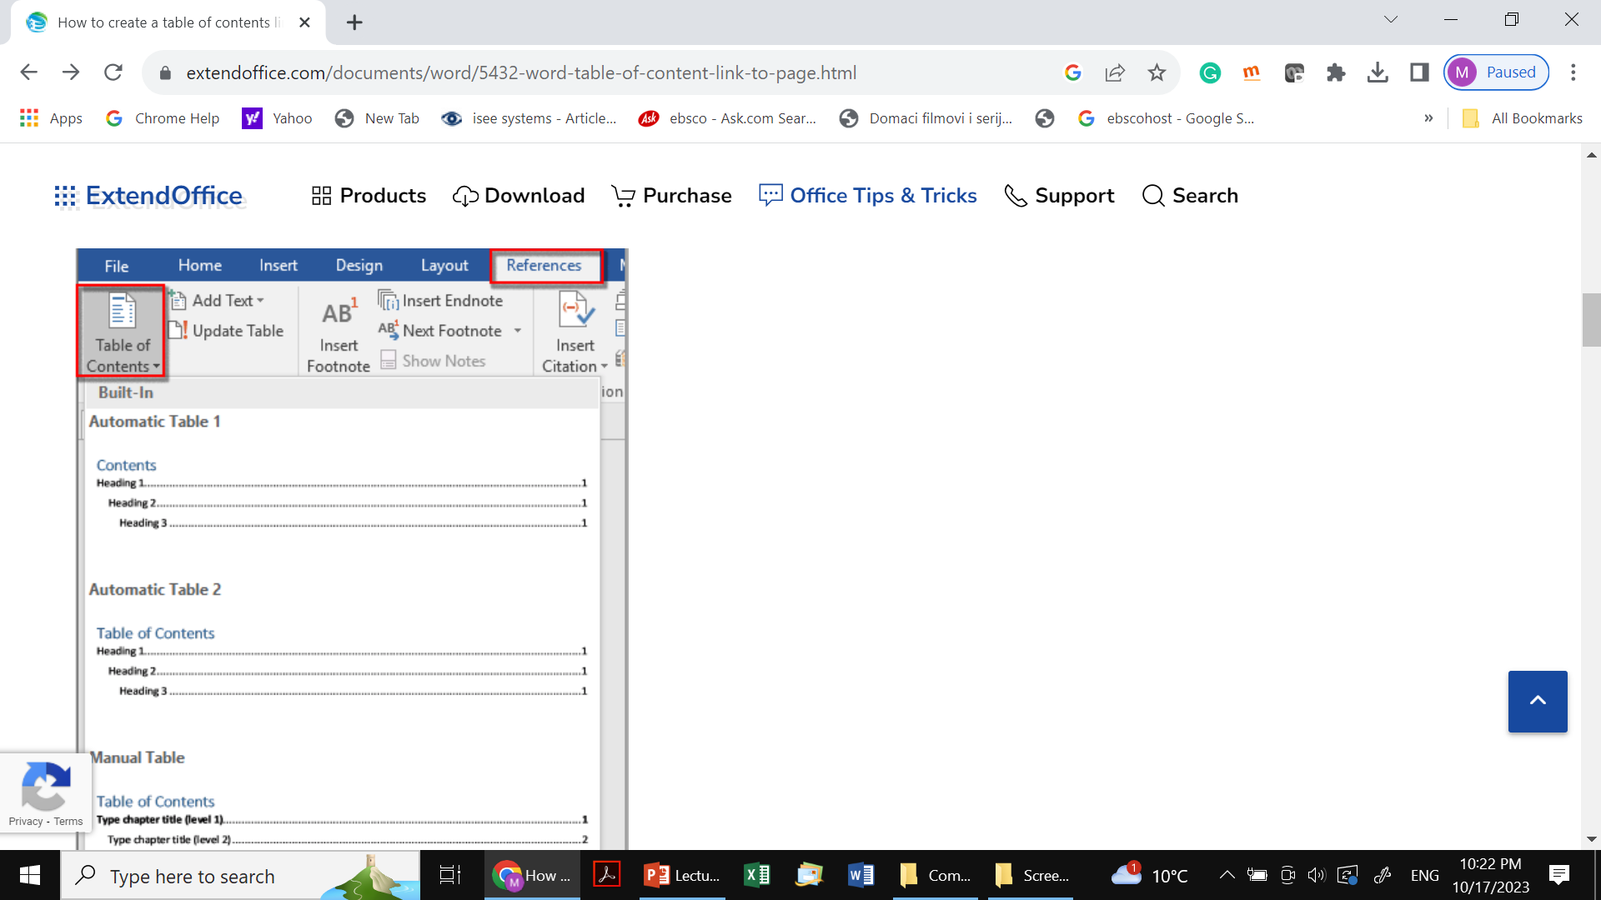
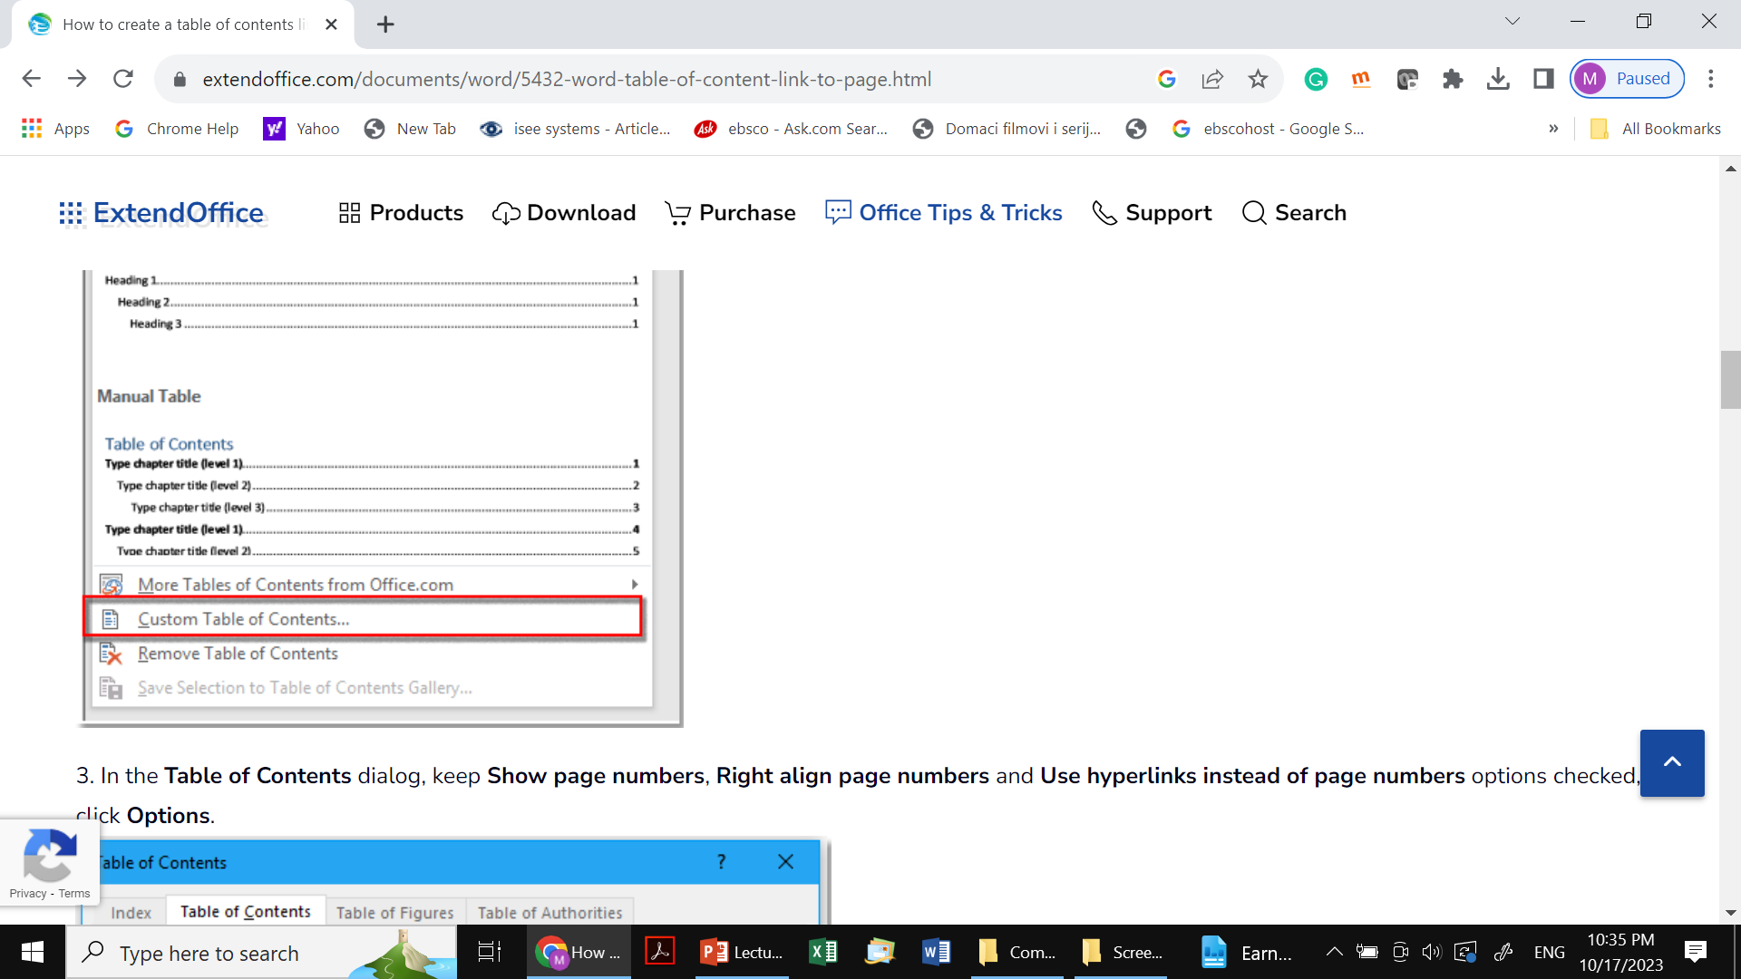
Table of contents link to a pages (cont.)
Firstly, use Styles under Home tab consistently throughout your document to create your own structure in your document.
Now place the cursor at the position you want to insert the table of linkable contents, click References > Table of Contents > Custom Table of Contents.

Slide 44
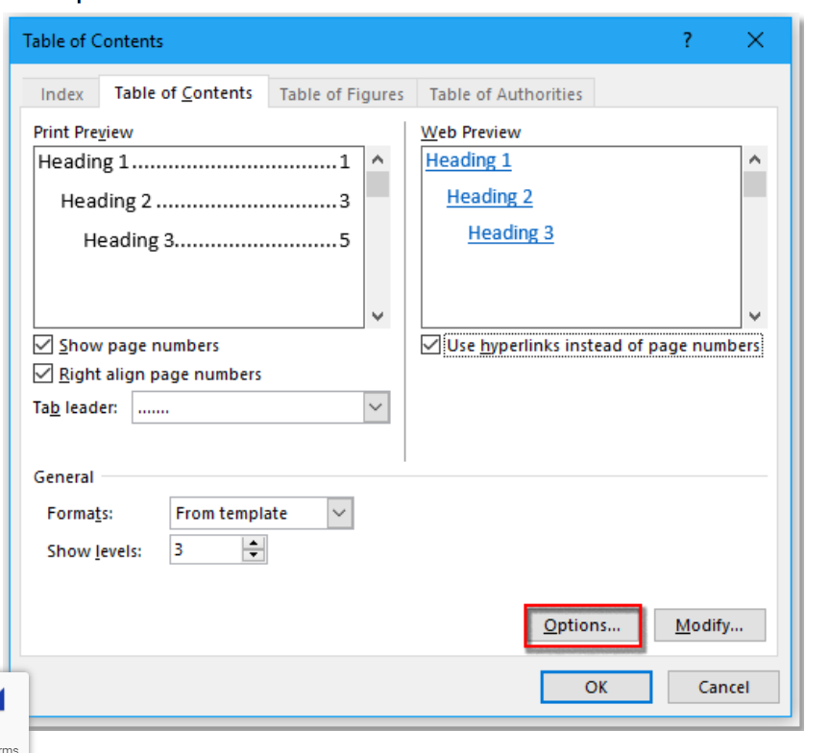
Table of contents link to a pages (cont.)
In the Table of Contents dialog, keep Show page numbers, Right align page numbers and Use hyperlinks instead of page numbers options checked, click Options.

Slide 45
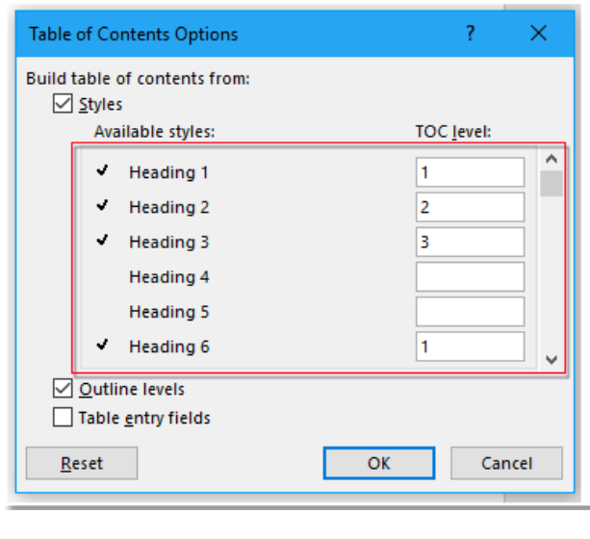
Table of contents link to a pages (cont.)
In the Table of Contents Options dialog, give the level to the relative heading you use. Click OK.

Slide 46
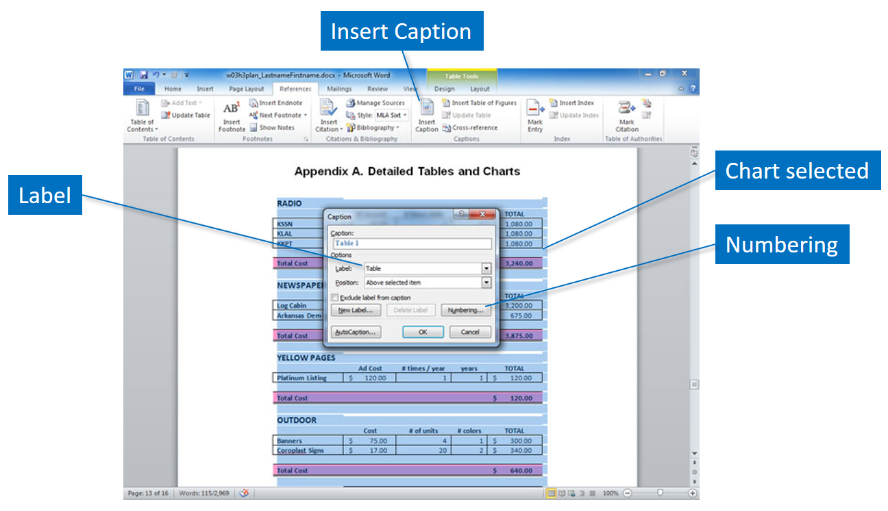
Figure captions
Depending on the requirements of the document you are producing, you may need to include additional reference tables to highlight other important data in the document. For instance, if you have a number of tables, images, or charts in your document, it might be helpful to have a table of figures as well as a table of contents and an index. Home > References > Insert Caption.

Slide 47
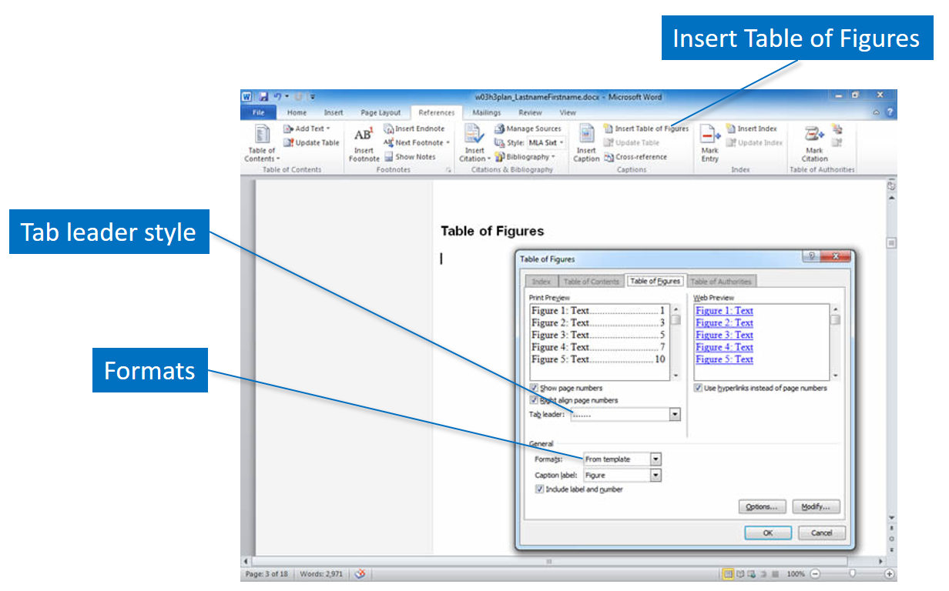
Table of figures
The table of figures lists the captions for each image, chart, or table in the document, along with the page number of the location of the object. The captions will be sorted by number and the table of figures will be inserted into the document. Normally the table of figures is placed after the table of contents in the document. Click Insert Table of Figures in the Captions group of the References tab to display the dialog box shown here. You can select the page number, format, and caption label options in this dialog box.

Slide 48
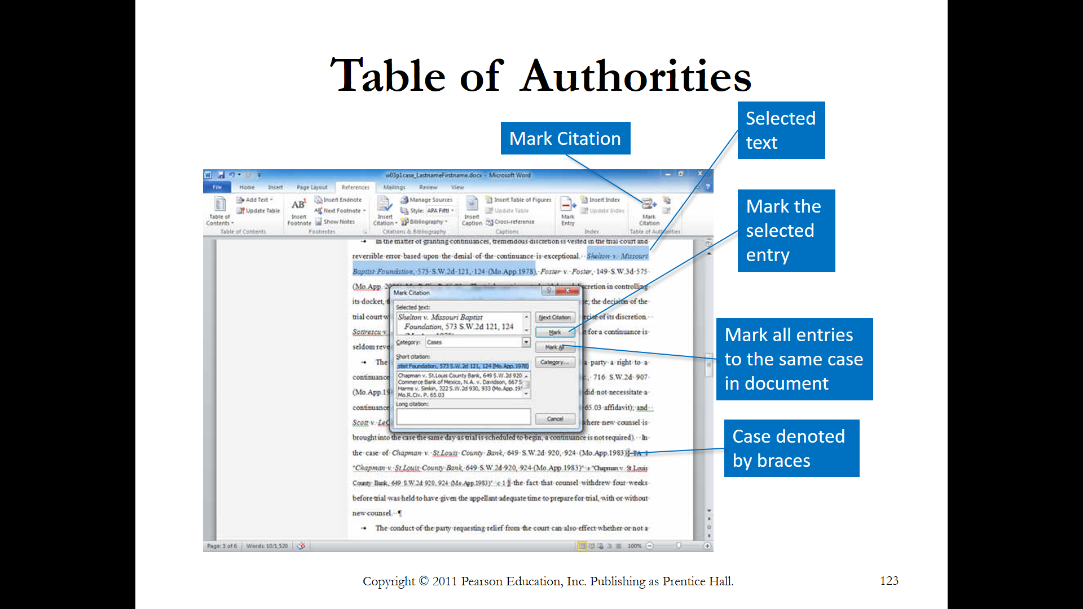
Table of authorities
A table of authorities is used in legal documents to reference cases, rules, treaties, and other documents referred to in the legal brief. It is normally located on a separate page at the beginning of a legal document. Shown here is a case, highlighted in the text, and the accompanying Mark Citation dialog box used to track the items to include in the table of authorities. Click Mark Citation in the Table of Authorities group on the References tab, select the category, and type the information. When you have selected all of the references in the document, click Insert Table of Authorities.
Modify an entry in the table of authorities by displaying the fields using Show/Hide in the Paragraph group on the Home tab. Locate the entry and modify the text inside the quotation marks. Do not make modifications to the actual table of authorities, as they will be lost when the table is next updated.

Slide 49
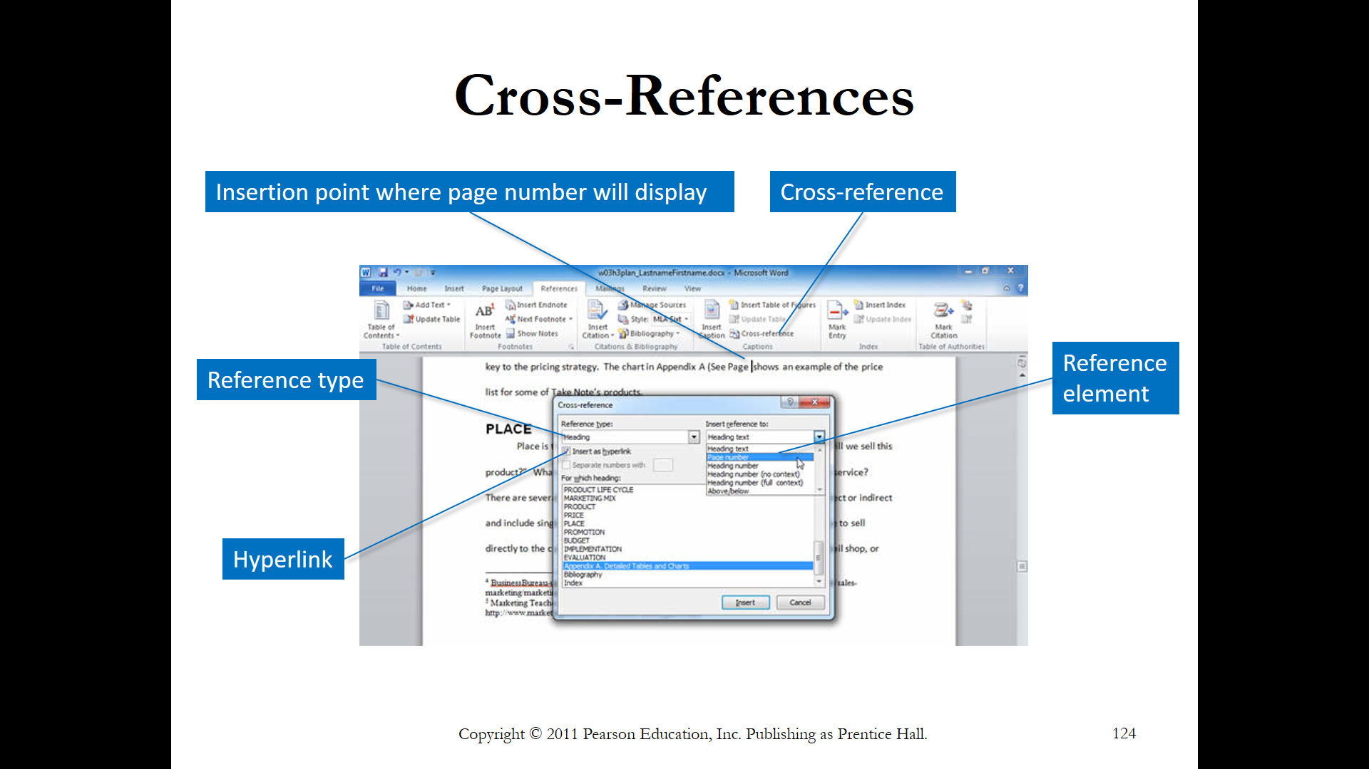
Cross references
Cross-references are used in documents to direct the reader to other locations for more information about the topic. You can create automated cross-references to headings, bookmarks, footnotes, endnotes, captions, and tables using Word. If you set up the cross-references, the page number will be automatically inserted and updated as the text of the document is edited. A hyperlink can be set to documents available via e-mail or on an intranet.
To create a cross-reference, position the insertion point in the location where the reference occurs. Click Cross-reference in the Captions group of the References tab. The Cross-reference dialog box, shown here, enables you to select the type of reference, such as a heading, bookmark, or footnote, and then the reference element to display, such as the page number of paragraph text. If you specify that a hyperlink is included, a Screen Tip will appear when the mouse pointer hovers over the cross-reference and moves to the cross-referenced location when clicked. A static entry, without a hyperlink, just displays a page number.

Slide 50
Useful links
https://support.microsoft.com/en-us/office/word-for-windows-training-7bcd85e6-2c3d-4c3c-a2a5-5ed8847eae73
Word for Windows trainig

Slide 51
Thank you for your attention!

